Slide 1
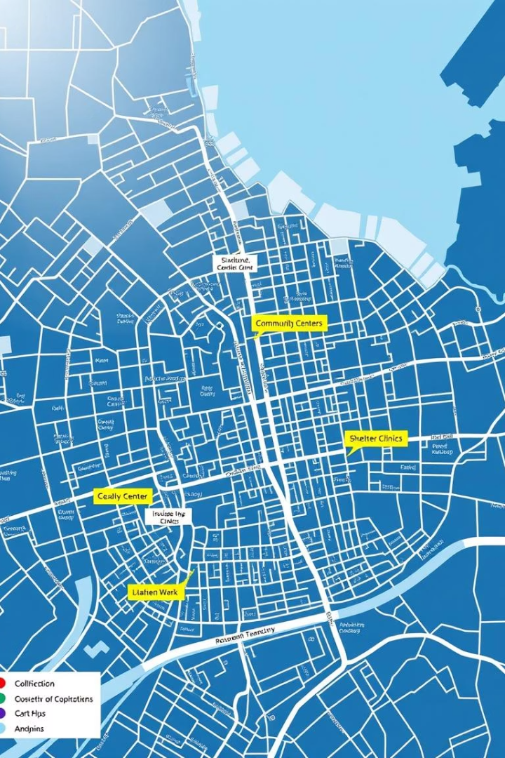

Community Resource Finder — Pitch Deck
A smart solution to connect people quickly with local community resources during emergencies and everyday needs.
by Edwin Mwiti

Slide 2
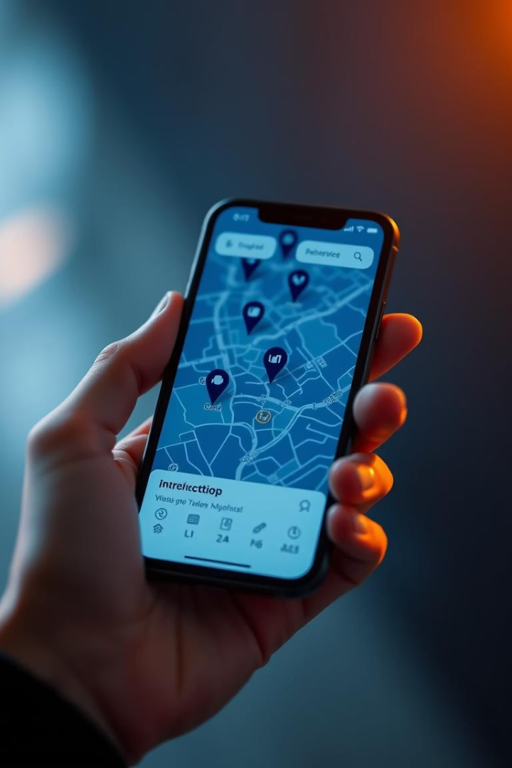
Welcome to Community Resource Finder
AI-powered suggestions
Visual map interface
Find resources tailored to your needs
Easy-to-use mapping with real locations
Vibe Coding Hackathon 2025
Introducing our innovative community tool

Slide 3

Understanding the Problem
Resource Access Issues
Fragmented Information
People struggle locating food banks and clinics
Current info scattered, hard to find quickly
Urgency in Emergencies
Fast, accurate info can save lives

Slide 4
Our Solution
Easy Location Search
AI Recommendations
Visual Map Integration
Mobile Friendly
Accessible on any device, anytime
Find resources near you with one input
Google Maps API for intuitive navigation
Personalized suggestions for your needs

Slide 5
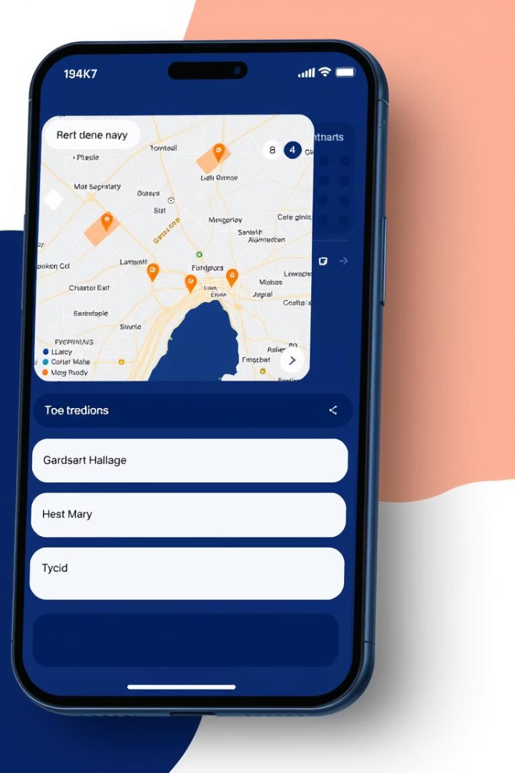




Key Features
Nearby Search
AI Suggestions
Interactive Map
Mobile Optimized

Slide 6

Technology Stack
Frontend
1
HTML, CSS, JavaScript
2
Mapping
Google Maps JavaScript API
AI Logic
3
Keyword-based suggestions, scalable to full AI
4
Hosting
Static hosting via GitHub Pages

Slide 7




Market Opportunity
Community Organizations
1
2
NGOs and Governments
4
3
General Public
Emergency Responders

Slide 8
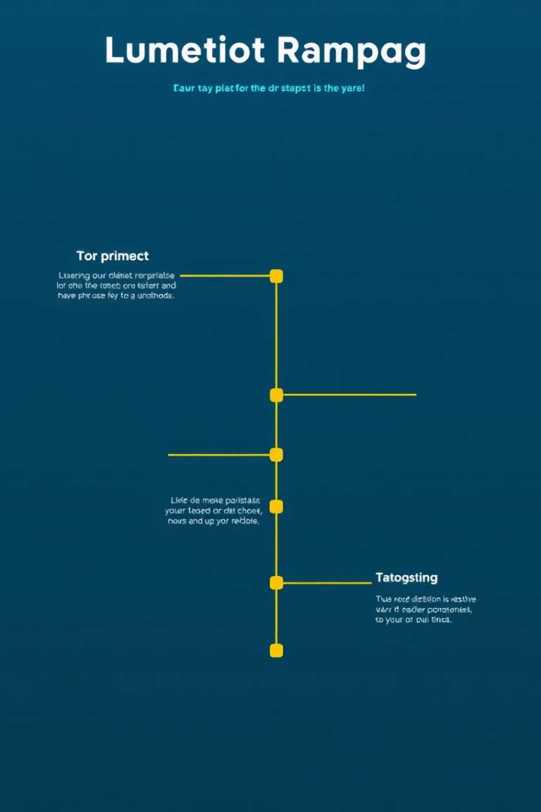




Roadmap & Next Steps
Integrate AI NLP APIs
User Accounts
Multi-language Support
Mobile App Development

